Slide 1
ASU Fall Fest Hackathon
Quantum club

Slide 2
Structure
Qiskit Code
Analysis of your solution
5 min Presentation

Slide 3
Judging Criteria
Effectiveness
Creativity,
Code Hygeine
Presentation
Connect to real world impact.

Slide 4
Prompt 1 – Protein Prediction
Predicting a protein’s three-dimensional structure from its amino acid sequence remains a central challenge in molecular biology. While AI-based methods such as AlphaFold have achieved remarkable success, they often struggle with sequences lacking known structural homologs. Physics-based free modeling approaches offer greater accuracy in principle but are computationally prohibitive on classical hardware.
Quantum computing offers a fundamentally different approach. By combining quantum algorithms with coarse-grained lattice models, which discretize protein structures into simplified representations, quantum processors can efficiently sample the vast conformational landscape of proteins. However, the choice of lattice model significantly impacts accuracy and resource demands. Tetrahedral lattices are efficient but too rigid to model key secondary structures. In contrast, face-centered cubic (FCC) lattices provide higher geometric fidelity, enabling more realistic folding patterns such as α-helices and β-sheets, though at increased quantum resource cost.
Your challenge is to go further: design a quantum algorithm for protein structure prediction using a 3D lattice model of your choice, with a focus on leveraging the capabilities of current IBM quantum hardware (Eagle R3, Heron R2). Go beyond the tetrahedral and FCC lattices, explore possibilities such as body-centered cubic (BCC), custom hybrid lattices, and others to balance biological realism with quantum efficiency.
Getting started:
● Create a quantum algorithm that predicts the folded structure of a short protein (5–10 amino acids) by minimizing a Hamiltonian that encodes energy terms and structural constraints on your chosen 3D lattice. Use Qiskit to:
● Encode the protein’s fold using turn-based or coordinate-based lattice encodings.
● Construct Hamiltonians that account for interaction energies (e.g., hydrophobic-polar, Miyazawa-Jernigan)

Slide 5
Modeling Protein 3D Structure
The Problem:
Why It's Intractable Classically:
The Astronomical Search Space: The number of possible folds for even a small protein is enormous (∼10300 for a typical sequence).
This is Levinthal's Paradox—finding the correct fold by random search is impossible.
The Energy Landscape: The correct fold is the unique global minimum on a complex, high-dimensional energy landscape. Classical algorithms get stuck in local minima.
Exponential Scaling: The difficulty scales exponentially with protein length, quickly overwhelming classical supercomputers for accurate, physics-based simulations.
Limitations of Current Solutions:
AI (AlphaFold): Highly successful but struggles severely with novel sequences that lack known structural homologs.
Physics-Based Modeling: While theoretically the most accurate, it is simply computationally prohibitive due to the immense conformational space to explore.

Slide 6
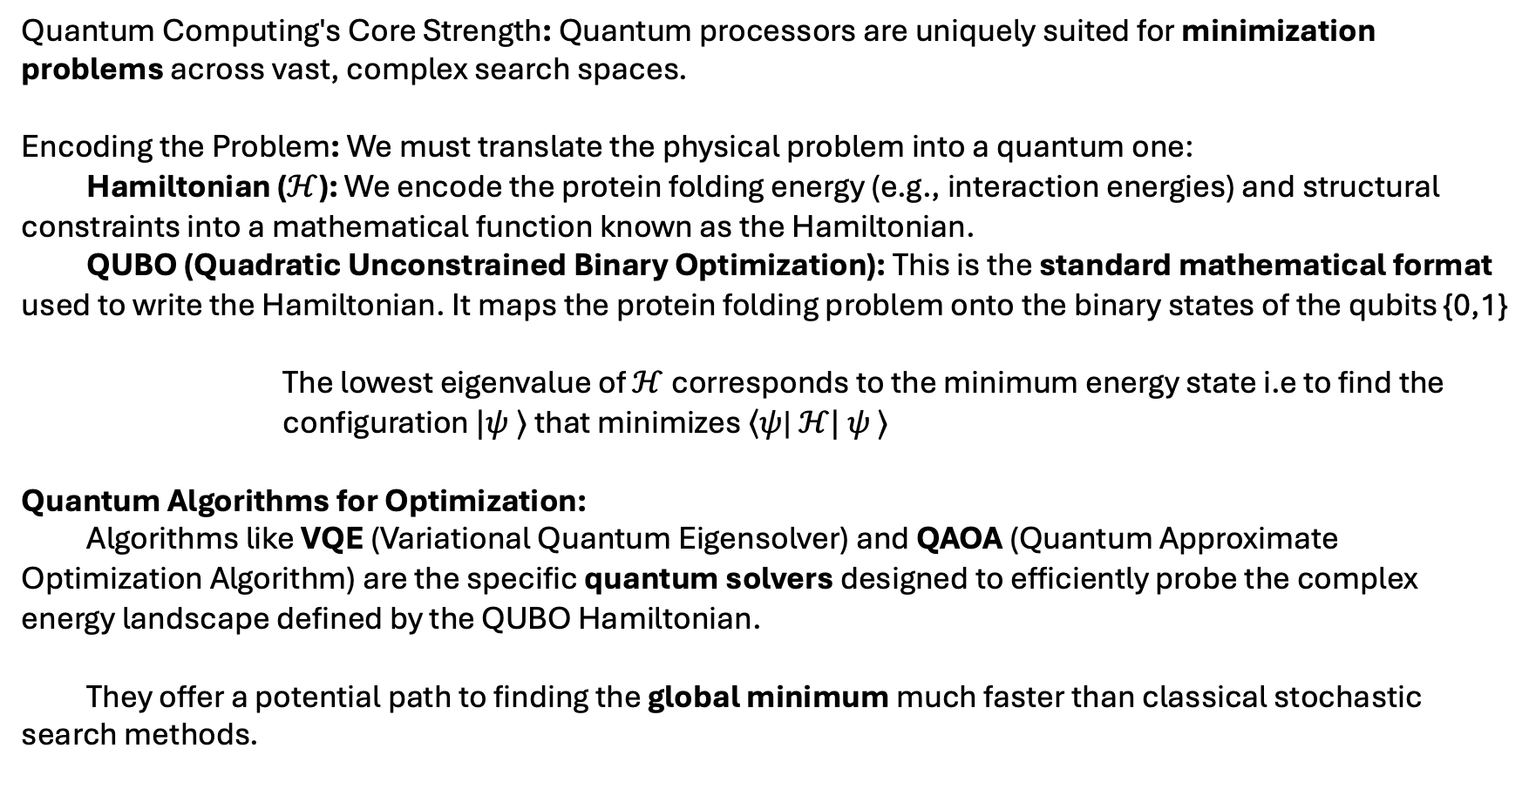
The Opportunity
Quantum Computing's Core Strength: Quantum processors are uniquely suited for minimization problems across vast, complex search spaces.
Encoding the Problem: We must translate the physical problem into a quantum one:
Hamiltonian ($ℋ$): We encode the protein folding energy (e.g., interaction energies) and structural constraints into a mathematical function known as the Hamiltonian.
QUBO (Quadratic Unconstrained Binary Optimization): This is the standard mathematical format used to write the Hamiltonian. It maps the protein folding problem onto the binary states of the qubits {0,1}
The lowest eigenvalue of $ℋ$corresponds to the minimum energy state i.e to find the configuration $|ψ$ $⟩$ that minimizes $\left\langle ψ\right.$| $ℋ|$ $ψ$ $⟩$
Quantum Algorithms for Optimization:
Algorithms like VQE (Variational Quantum Eigensolver) and QAOA (Quantum Approximate Optimization Algorithm) are the specific quantum solvers designed to efficiently probe the complex energy landscape defined by the QUBO Hamiltonian.
They offer a potential path to finding the global minimum much faster than classical stochastic search methods.
The Goal:

Slide 7
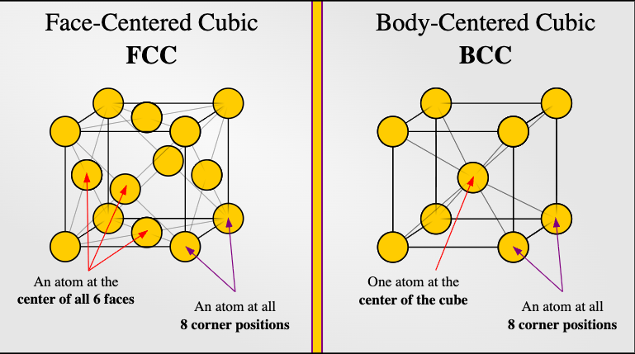
The Design Challenge
The Problem in Quantum Folding: The geometric representation of the protein is the largest resource bottleneck on current quantum hardware.
The Current Trade-Off:
Tetrahedral: Highly efficient (low qubit count) but too rigid to accurately model key structures like α-helices.
Face-Centered Cubic (FCC): Higher geometric fidelity (better realism) but demands a significantly increased quantum resource cost (more qubits, deeper circuits).
Go past the standard models. Explore possibilities like Body-Centered Cubic (BCC), custom hybrid lattices, or other novel geometric representations.
Tetrahedral
Your Mission The BCC and Beyond :
The Goal:
Design a lattice that balances biological realism (allowing for realistic folding angles and patterns) with quantum efficiency (minimizing the required qubit count and circuit depth for IBM hardware)

Slide 8
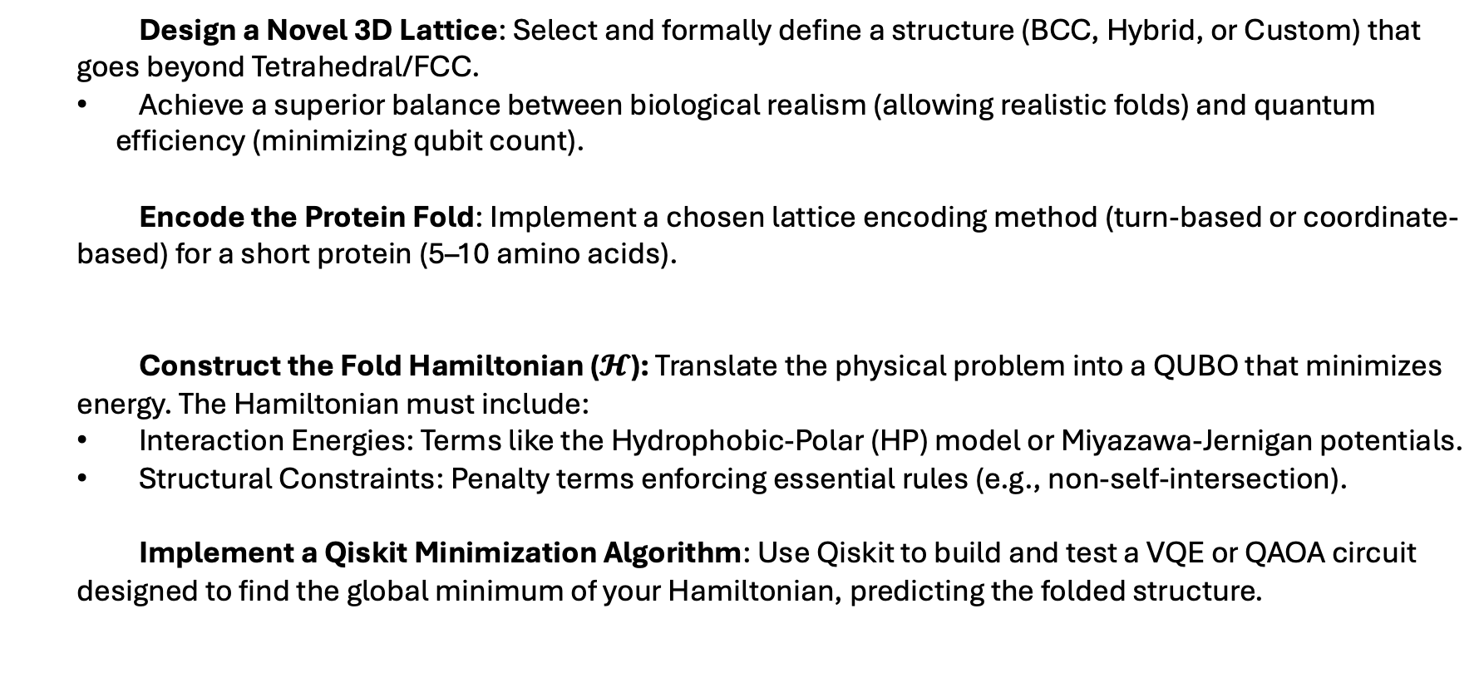
The Expectations
Step 1
Design a Novel 3D Lattice: Select and formally define a structure (BCC, Hybrid, or Custom) that goes beyond Tetrahedral/FCC.
Achieve a superior balance between biological realism (allowing realistic folds) and quantum efficiency (minimizing qubit count).
Encode the Protein Fold: Implement a chosen lattice encoding method (turn-based or coordinate- based) for a short protein (5–10 amino acids).
Construct the Fold Hamiltonian ($𝓗$): Translate the physical problem into a QUBO that minimizes energy. The Hamiltonian must include:
Interaction Energies: Terms like the Hydrophobic-Polar (HP) model or Miyazawa-Jernigan potentials.
Structural Constraints: Penalty terms enforcing essential rules (e.g., non-self-intersection).
Implement a Qiskit Minimization Algorithm: Use Qiskit to build and test a VQE or QAOA circuit designed to find the global minimum of your Hamiltonian, predicting the folded structure.
Step 2
Step 3
Step 4

Slide 9
Prompt 2 – Quantum Key Distribution (QKD)
Using Qiskit, you will build a fully functional BB84 Quantum Key Distribution prototype that runs on real or simulated quantum hardware. The goal is demonstrating how two parties can establish a shared secret key with information-theoretic security. Your implementation should include end-to-end key generation, measurement and sifting procedures, and error‐rate estimation to detect any eavesdropping. You’ll collect and plot key metrics and illustrate how these values shift when you introduce noise. By comparing performance under different conditions, you will showcase the practical feasibility of BB84 on today’s quantum platforms and highlight the utility of the approach.
After you validate the implementation, create an informative presentation that teaches the fundamentals of QKD and places it in the broader context of post-quantum encryption. Make sure you compare BB84 to at least one other emerging approach, discussing how these algorithms resist quantum attacks

Slide 10

BB84 QKD
Problem Set Up:
We are given two distant parties: Alice and Bob. They wish to share a secret key using a quantum channel that may be disturbed by an eavesdropper (Eve).
The channel takes quantum bits as input and produces measurement outcomes as output.
Case 1: No Eavesdropper / Low Noise Qubits travel undisturbed. Alice and Bob measure in matching bases → identical bits → secure key.
Case 2: Eavesdropping or High Noise Eve measures and resends, disturbing the states. Basis mismatches appear → elevated QBER (Quantum Bit Error Rate) → security compromised.
Goal:
Use Qiskit to implement BB84, generate and sift keys, and show how QBER changes with noise or eavesdropping.

Slide 11
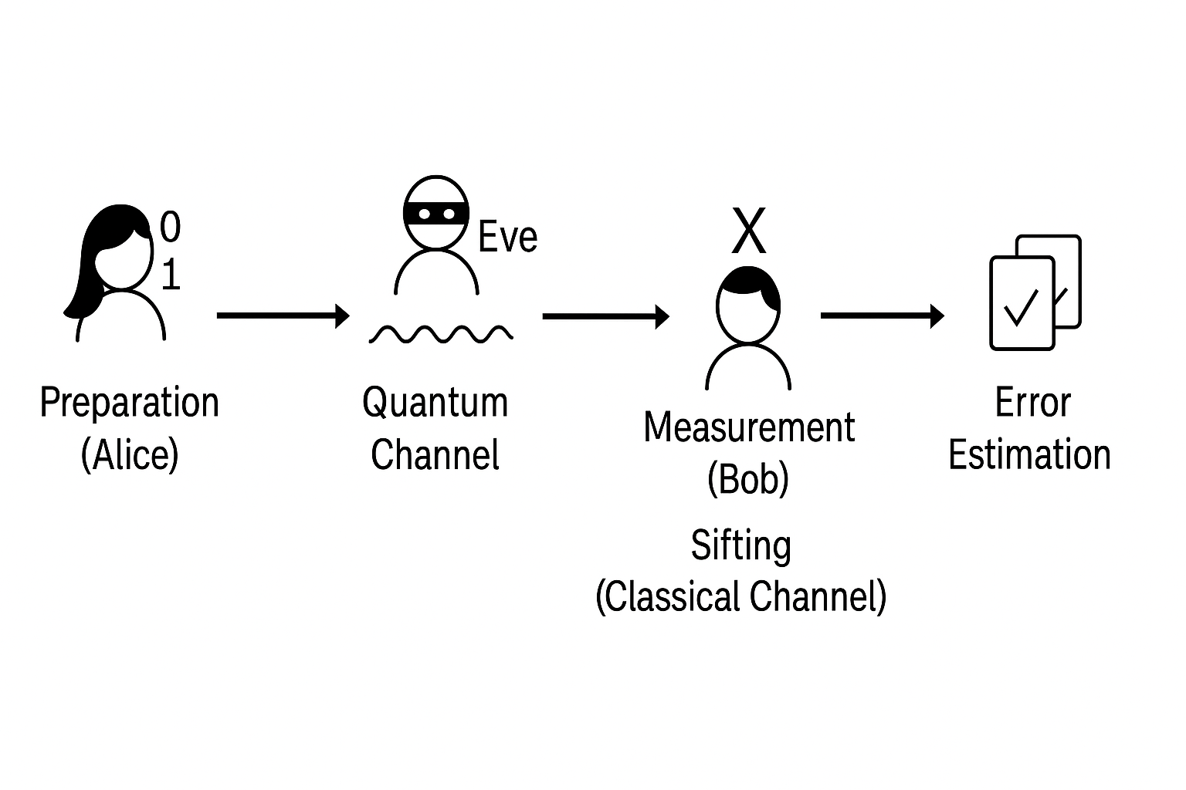
How does it work?
Step 1 — Preparation (Alice): Alice creates random bits (0s and 1s) and random bases (Z or X). Each bit + basis pair defines a quantum state: ∣0⟩,∣1⟩,∣+⟩,∣−⟩
Step 2 — Transmission (Quantum Channel): Alice sends the qubits to Bob through the quantum channel. Each qubit can be disturbed if Eve tries to measure it.
Step 3 — Measurement (Bob): Bob randomly chooses a measurement basis (Z or X) for each qubit. He records his results — many will not match Alice’s bits yet.
Step 4 — Sifting (Classical Channel): Alice and Bob publicly compare their bases (not bit values). They keep only matching bases → this forms the sifted key.
Step 5 — Error Estimation: They compare a small sample to compute the Quantum Bit Error Rate (QBER). If QBER is too high → likely eavesdropping or noise → abort. If QBER is low → continue to error correction and privacy amplification.

Slide 12
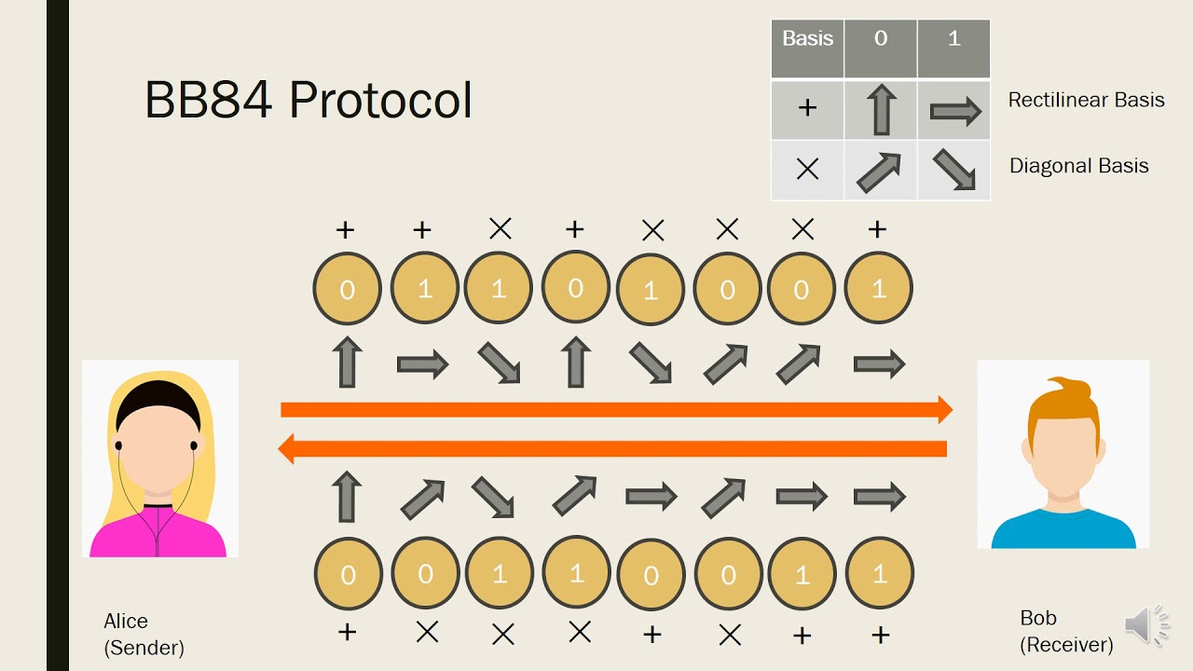
Understanding the question
We are challenged to implement and demonstrate the BB84 Quantum Key Distribution (QKD) protocol using Qiskit — showing how two parties can securely share a secret key, even in the presence of noise or eavesdropping.
What We’re Asked to Do:
Build an end-to-end BB84 system: preparation, measurement, sifting, and error estimation.
Use Qiskit simulators or real IBM Quantum hardware.
Visualize results (QBER, key length, error trends).
Compare performance under clean and noisy conditions.
What We’re Showing:
How quantum measurement makes eavesdropping detectable.
That secure key exchange is possible today on real quantum devices.
The role of BB84 as a foundation for quantum-safe communication.

Slide 13
Deliverables & Criteria
Deliverables
A Qiskit program that runs the BB84 QKD protocol with at least 4 bits exchanged.
Graphs showing how noise or eavesdropping change the error rate (QBER).
Criteria
🧩 Works: Code runs and shows clear results.
📊 Explains: You understand what the graphs mean.
💡 Connects: You explain how BB84 keeps data secure.
🎨 Shows effort: Clean, creative, and easy to follow.

Slide 14
Prompt 4 – EV Bomb Battleship
1993 saw Avshalom Elitzur and Lev Vaidman propose a thought-provoking Bomb Tester experiment designed to explore core fundamental quantum mechanics concepts: entanglement, superposition, and state collapse [4]. Their dramatic bomb tester thought experiment involved using a Mach-Zehnder interferometer to detect the presence of a bomb without detonating it. This was a revolutionary concept: the ability to gain information about an object without any direct interaction.
This hackathon challenges you to build upon the Elitzur-Vaidman Bomb Tester. Your mission is to extend this non-interactive probing method to a Battleship game grid, aiming to locate all ships without ""hitting"" them. In traditional Battleship, finding a ship means a direct hit or miss. However, the Elitzur-Vaidman Bomb Tester showcases the power of quantum mechanics to probe objects without interaction. In this hackathon you will develop a quantum circuit that leverages core quantum concepts to find every ship on the Battleship grid and secure victory before firing a single shot..

Slide 15
Understanding EV-Bomb
Starting from the basics.

Slide 16
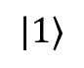
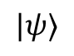
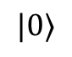
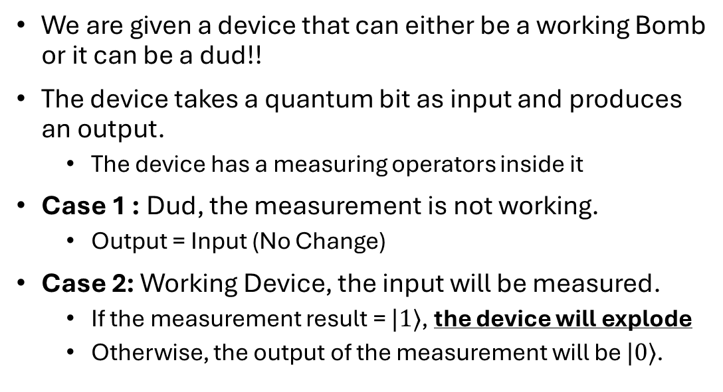
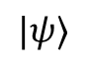
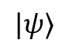
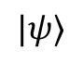
Elitzur Vaidman Bomb
Problem Set Up:
We are given a device that can either be a working Bomb or it can be a dud!!
The device takes a quantum bit as input and produces an output.
The device has a measuring operators inside it
Case 1 : Dud, the measurement is not working.
Output = Input (No Change)
Case 2: Working Device, the input will be measured.
If the measurement result = $|1⟩$, the device will explode
Otherwise, the output of the measurement will be $|0⟩$.
$$|ψ⟩$$
Case 1
Case 2
$$|ψ⟩$$
$$|ψ⟩$$
$$|ψ⟩$$
$$|0⟩$$
$$|1⟩$$
Goal:
Explode
Our Goal is to determine if this device is a Dud or a working Bomb without exploding the device.
Dud
Working

Slide 17

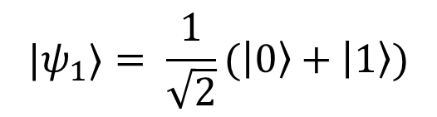
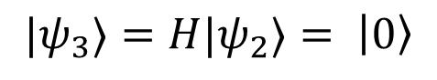
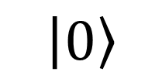
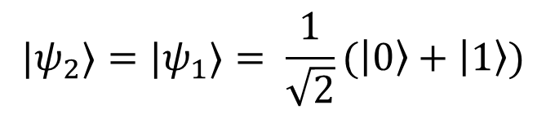
Approach 1: Superposition
Not Working
$$\left|0\right\rangle$$
H
H
$${|ψ}_{3}⟩={H|ψ}_{2}⟩= \left|0\right\rangle$$
$${|ψ}_{2}⟩={|ψ}_{1}⟩= \frac{1}{\sqrt{2}}(\left|0\right\rangle +\left|1\right\rangle )$$
$${|ψ}_{1}⟩= \frac{1}{\sqrt{2}}(\left|0\right\rangle +\left|1\right\rangle )$$

Slide 18
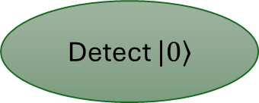
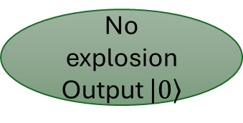
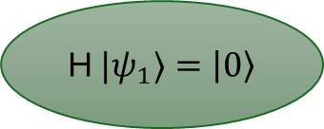
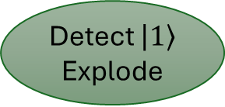
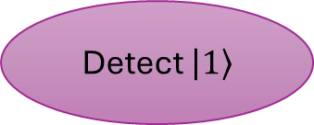
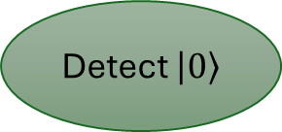
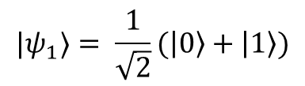
Detection Process
$${|ψ}_{1}⟩= \frac{1}{\sqrt{2}}(\left|0\right\rangle +\left|1\right\rangle )$$
1/2
1/2
Working
Bomb
Not Working
Bomb
1/2
1/2
Detect $\left|1\right\rangle$ Explode
No explosion
Output $\left|0\right\rangle$
H ${|ψ}_{1}⟩=\left|0\right\rangle$
1/2
1/2
Detect $\left|0\right\rangle$
Detect $\left|1\right\rangle$
Detect $\left|0\right\rangle$
Confusion
100% Chance of working bomb

Slide 19
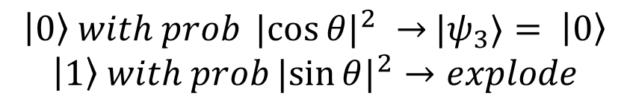
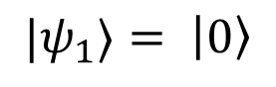
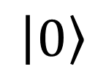
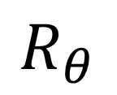
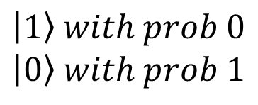
Approach 2: Rotation
N times
$$\left|1\right\rangle with prob 0$$
$$\left|0\right\rangle with prob 1$$
$$\left|0\right\rangle$$
$$R_{θ}$$
Working
$\left|0\right\rangle with prob {|cos{θ|}}^{2} →$ ${|ψ}_{3}⟩= \left|0\right\rangle$
$$\left|1\right\rangle with prob{|sin{θ|}}^{2}→explode$$
$${|ψ}_{2}⟩={R_{θ}|ψ}_{1}⟩=R_{θ}\left|0\right\rangle =\cos{θ\left|0\right\rangle +\sin{θ|1⟩}}$$
$${|ψ}_{1}⟩= \left|0\right\rangle$$

Slide 20
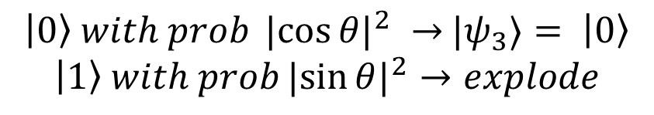
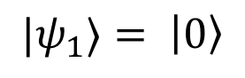
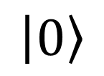
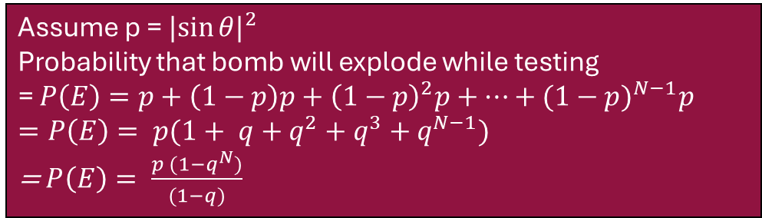
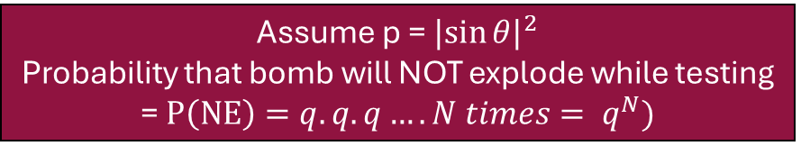
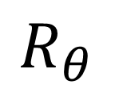
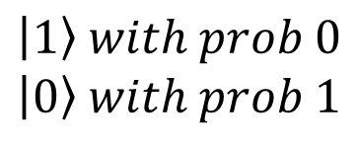
Reducing Probability of Failure
Assume p = ${|sin{θ|}}^{2}$
Probability that bomb will NOT explode while testing
= $P\left(NE\right)=q.q.q…. N times= q^{N})$
N times
$$\left|1\right\rangle with prob 0$$
$$\left|0\right\rangle with prob 1$$
$$\left|0\right\rangle$$
$$R_{θ}$$
Working
N | P(E)
2 | 85%
10 | 94%
20 | 97%
50 | 99.99%
500 | ~1
$\left|0\right\rangle with prob {|cos{θ|}}^{2} →$ ${|ψ}_{3}⟩= \left|0\right\rangle$
$$\left|1\right\rangle with prob{|sin{θ|}}^{2}→explode$$
$${|ψ}_{2}⟩={R_{θ}|ψ}_{1}⟩=R_{θ}\left|0\right\rangle =\cos{θ\left|0\right\rangle +\sin{θ|1⟩}}$$
Assume p = ${|sin{θ|}}^{2}$
Probability that bomb will explode while testing
= $P\left(E\right)=p+\left(1−p\right)p+{\left(1−p\right)}^{2}p+…+{(1−p)}^{N−1}p$
$=P\left(E\right)= p(1+ q+q^{2}+q^{3}+$ $q^{N−1})$
= $P\left(E\right)= \frac{p (1−q^{N})}{(1−q)}$
$${|ψ}_{1}⟩= \left|0\right\rangle$$

Slide 21
Problem Statement
Understanding the Question.

Slide 22
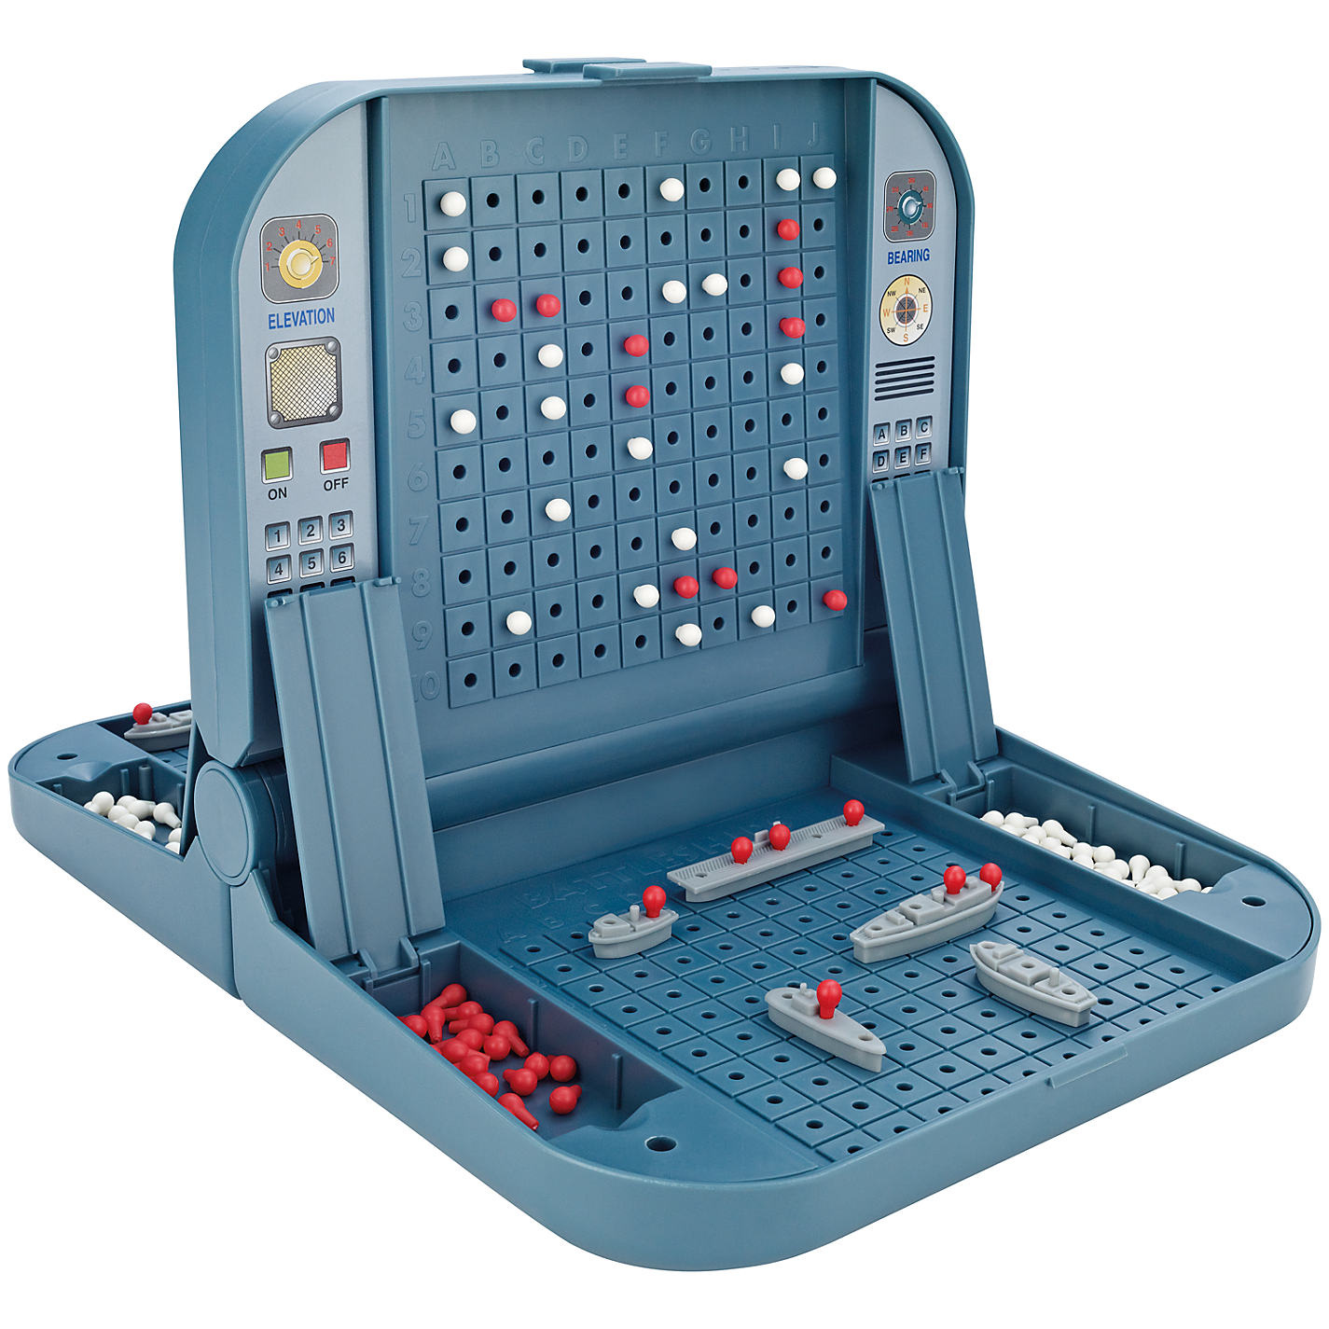
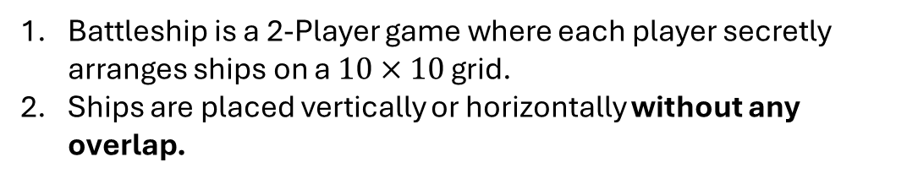
A Game of Battleship
Game Set Up
Battleship is a 2-Player game where each player secretly arranges ships on a $10×10$ grid.
Ships are placed vertically or horizontally without any overlap.
Gameplay
Players take turns calling out grid coordinates (ex. B7).
If there is a portion of the opponents ship on that coordinate, they must callout ‘Hit’.
If not they callout ‘Miss’.

Slide 23
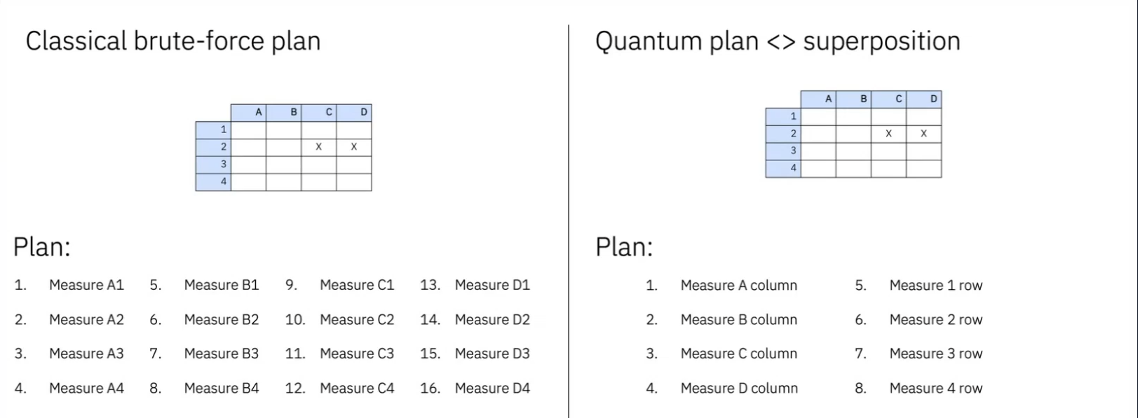
Quantum V/S Classical

Slide 24
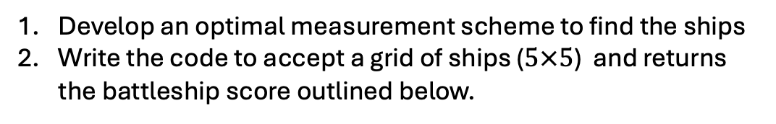
Deliverables & Criteria
Deliverables
Develop an optimal measurement scheme to find the ships
Write the code to accept a grid of ships ($5×5$) and returns the battleship score outlined below.
Criteria
Battleship Score: $\frac{\# Detection}{\# Explosion}⋅\frac{\# Measurement}{\# Brute−Force}$

